Slide 1
PREPARING THE professional PORTFOLIO
Presenter: Patricia Clarke

Slide 2


Slide 3
OBJECTIVES
This presentation aims to answer three main questions:
What is a Professional Portfolio ?
Why is a Professional Portfolio important?
How to create a Professional Portfolio.

Slide 4
WHAT IS a teacher PORTFOLIO?
The teacher portfolio is an evidence driven professional folder or tool which outlines the philosophy, growth and development of the teacher.
Simply put, it stands as a professional documentation of a teacher.

Slide 5
IMPORTANCE OF A professional PORTFOLIO
The portfolio is an essential tool for assessment that:
provides strong evidence to support your assertions as a teacher.
provides a source of motivation through positive feedback

Slide 6
(CONTI.)
provides information about your teaching style and abilities and your achievements during your teaching career.
outlines your professional journey

Slide 7
Creating your teacher portfolio
Creating your professional portfolio is an ongoing process; as you gain more experience you will continually update the items to show your best qualities and achievements.

Slide 8
WHAT SHOULD BE INCLUDED?
While the creation of your professional portfolio allows your creativity to shine, there are some common elements. These include:
Teaching Philosophy
Resume and Cover Letter

Slide 9
(CONTI.)
Degrees/Certifications/Awards
Lesson Plans/Resources
Samples of students’ work
Co-curricular activities
Miscellaneous

Slide 10
TEACHING PHILOSOPHY
Your teaching philosophy is a self-reflective statement of your beliefs about teaching and learning. It's a one to two page narrative that conveys your core ideas about being an effective teacher in the context of your discipline.
https://cei.umn.edu/writing-your-teaching-philosophy

Slide 11
SAMPLE
As a secondary education teacher, I strongly believe that fostering critical thinking skills is at the heart of what we do in education. I am committed to giving students the tools they need to see their own value, analyze information and situations, and effectively solve problems. Using case studies, real-life examples, and thought-provoking questions, I encourage students to consider their role and how they fit in society. I believe in making social studies concepts real through field trips, hands-on activities, and other interactive learning tools.

Slide 12
(CONTI.)
Although I am committed to teaching the core educational requirements for each age group and providing the feedback that comes with grading, I want to go beyond standardized assessments and create a sense of leadership and capability in my students as citizens of the community.

Slide 13
Resume and Cover Letter
Your resume is a brief document that summarizes you as a job candidate with a focus of education and qualification. One the other hand, your cover letter gives you an opportunity to demonstrate more of your personality and ambitions that make you a good fit for the organization.

Slide 14
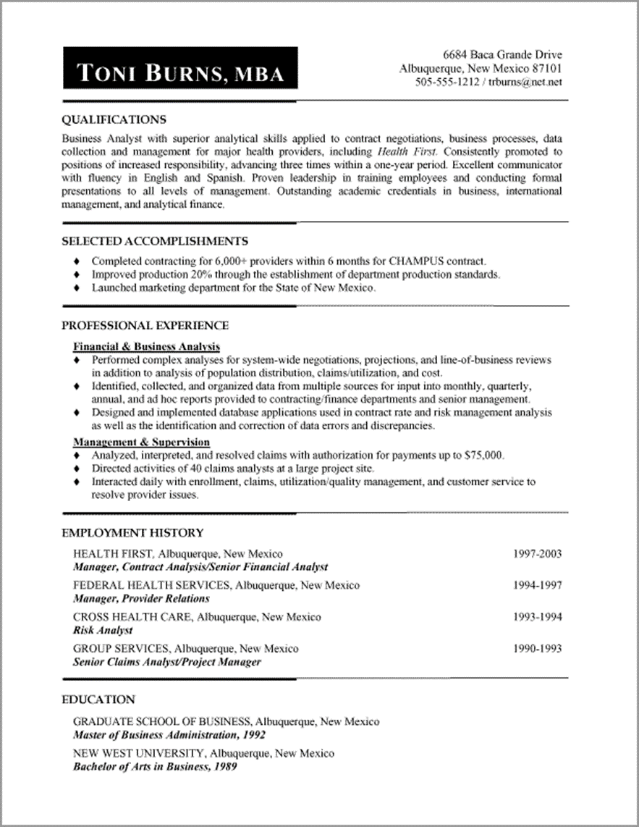
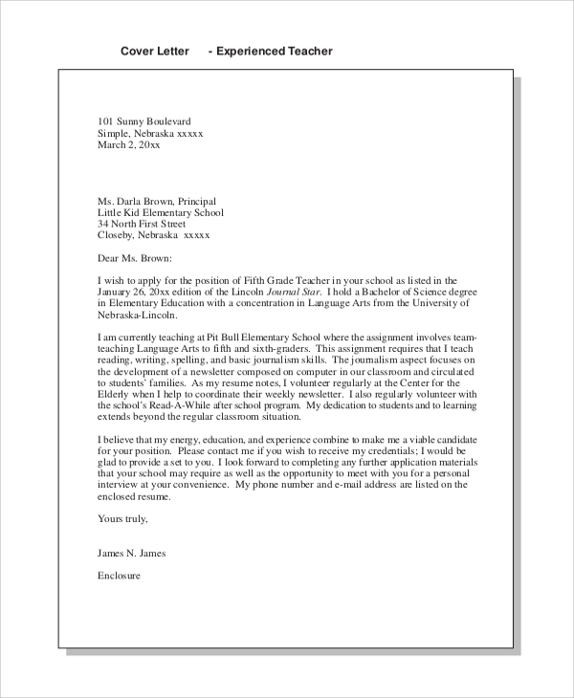
Sample resume and cover letter

Slide 15
Degrees/Certifications/Awards
These would include:
Copy of Degree Instrument (s)
Professional Development Certificate (s)
Special Awards (Teacher of the Month/Year etc.)

Slide 16
MISCELLANEOUS
This would include:
Correspondences from the school (evidence of school involvement)
Photographs from excursions, sports day activities etc.
Evidence of volunteer work
Special awards (from students or parents etc.)

Slide 17
Summary
Essentially, your professional portfolio is your most important asset that proves unequivocally:
Who you are / what you believe as a teacher /educator
Your capacity to handle the core responsibility of students’ academic and social development
Your level of involvement in your institution as a whole
Your level of growth as time progresses

Slide 18

Thank
You
For
Your
Attention.

